Slide 1
Explore trends on boat and yacht online searches.
Presented by: Tran Dinh Duc
Last updated on: December 8th, 2021

Slide 2
Ultimate goal: Design a newsletter with information on market trends for boat sellers.
Objective: Identify what boat sellers want to know about: most viewed products’ characteristics that are being listed on website.
Analytical Goals
1
2
3
An overview of online boat searches.
Examine weekly trends in online boat & yacht searches using historical data.
Discuss potential areas for further exploration.
Notes:
Cover how boat searches happen in the past 7 days and what that means for boat sellers.
Understanding trends/common features in online searches to help sellers make decision about stocking needs and forming future plans.
Dive deep into areas that is of most important to sellers’ business.

Slide 3
Executive summary
Price and View counts
  Potential buyers often seek for boats under medium-priced range.
Most viewed boats’ common features
  GRP (Glass Reinforced Plastic) is the most-sought boat’s material, while Diesel and Unleaded are two highly searched engine types.
  Boat’s sizes are also a good indicator of viewer’s buying tendency.
  Boats that have been used before often get considerable attention from viewers. However, new boat freshly taken from stock that was built recently in 2020 also capture a great amount of attention from buyers.
Notes:
Less than a million. No relation between price and number of views for the last 7 days has been observed so far.
This may relate to the purchasing power of viewers, as they may prefer a less pricey boats but still in good conditions. Or maybe, they want to purchase a well-sustained product despite of its age.

Slide 4
Price and view counts
Price range (in USD)
$10,000 - $100,000
791,232
$100,000 - $1,000,000
546,073
$1,000,000 - $10,000,000
70,602
Less than $10,000
61,145
More than $10,000,000
5850
Total view counts
Notes:
- Boats with price fall under 10,000 USD - 100,000 USD category get the highest views. Overall, viewers search more of a boat that's not too cheap as the number of searches for boat priced from 100 – 1 million is also remarkable, or too overpriced, as only a few search for boat valued over 10,000,000
- This indicates that not the most expensive boats always get the highest attention. By analysing the data, we can confirm the correctness of the initial assumption.

Slide 5
Most viewed boats’ common features
Condition | Engine type | Year Built | Views last 7 days
New boat from stock | Unleaded | 2020 | 67739
New boat from stock | Unleaded | 2019 | 27670
Used boat | Diesel | 2009 | 22033
Used boat | Diesel | 2008 | 30865
Used boat | Diesel | 2007 | 26941
Used boat | Diesel | 2006 | 29872
Used boat | Diesel | 2005 | 18897
Used boat | Diesel | 2004 | 24668
Used boat | Diesel | 2003 | 1830
Used boat | Diesel | 2002 | 18749
Total view counts
Engine type
30,000
Diesel
25,000
20,000
15,000
10,000
5000
0
Year Built
1880
1900
1920
1940
1960
1980
2000
2020
Notes:
Diesel and Unleaded are so far the two most highly-searched engine types that capture highest degree of attention from potential buyers.
However there is a distinction between level of interest for these two types of engine, mostly by the year the boat was built.
For any boat type that was built back over a decade ago, Diesel engine is the most favourite; while for boats that were newly built, unleaded is all the rage.

Slide 6
Most viewed boats’ common features
GRP
71.18
Other
3.07
Aluminium
3.14
Plastic
4.14
7.60
Wood
9.90
PVC
Steel
Notes:
- Boats made from GRP (Glass Reinforced Plastic) are the current fashion among buyers, with total views from last 7 days comes at nearly 900 millions, accounting for 71% percent of total views. There could be further analysis on this feature, discovering while this material gets all this attention.

Slide 7
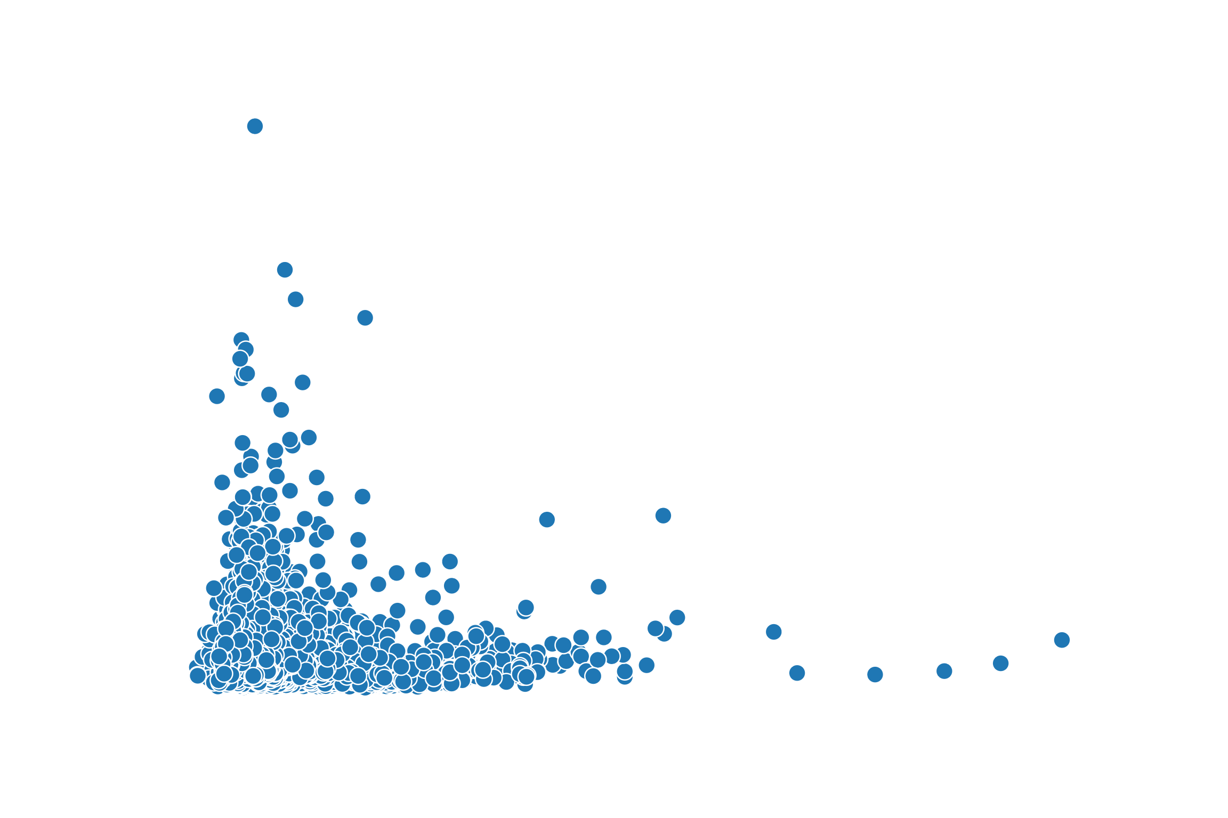
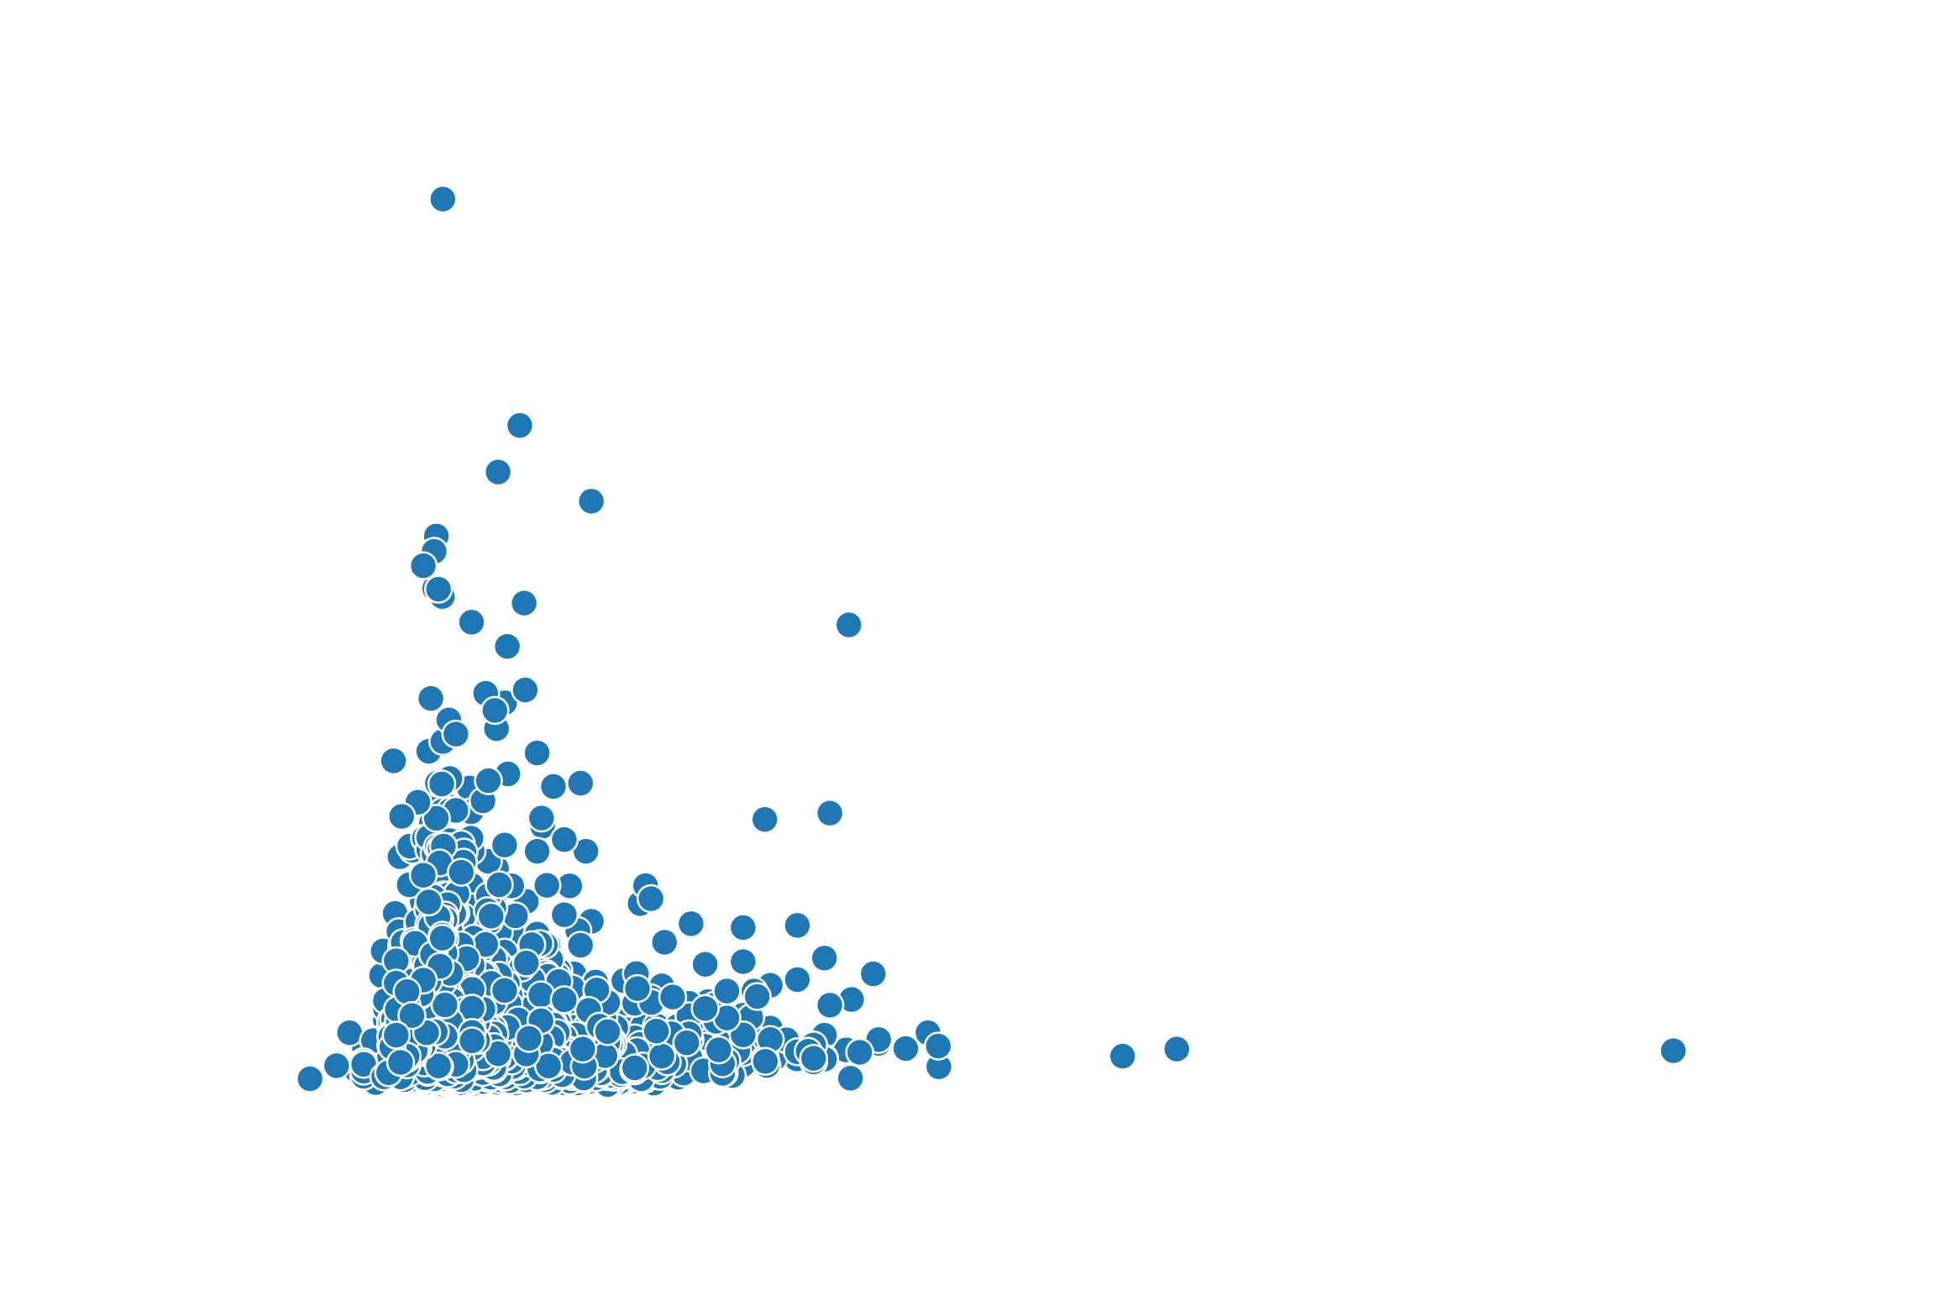
Most-viewed boats’ common features
View counts
View counts
3000
3000
2500
2500
2000
2000
1500
1500
1000
1000
500
500
0
0
Length
Width
0
20
40
60
80
100
0
5
10
15
20
25
Notes:
Distribution of view counts by length and width
Buyers tend to search for small to medium-sized boats, with length not greater than 40 meters and width not greater than 10 meters. As the size of the boats reduced, the interests from buyers grow much higher.

Slide 8
Recommendations and possible further analysis
Recommendations
  A primary section focusing on boats lying under medium-priced range in the newsletter may help boat’s owners be well-informed about viewer’s purchasing power.
  The newsletter should provide boat sellers with updated information on viewer’s favourite boat conditions, popular engine types, sizes and materials to help them with business decision. Getting these information, sellers may make decision well in time to cater for customers’ needs.
  Marketing content team could also write articles on tips or know-how posts that could help boat owners maintain and preserve their old boat’s conditions if they want to sell it later.
Further exploration:
  What are the top prioritized criteria when it comes to choosing boats? (endurability, elegance, or price efficiency, etc.)
  Does the buyer’s preferences vary by certain timeframe (seasons)?
Notes:
Now we are conducting the analysis on a weekly basis, the timeframe is quite small to capture the macro trends. What if we scale it up a bit to a seasonal analysis, to discover whether the preferences for boats change during the course of a year.
Like maybe in summer they want an elegant sport boat to travel around with friends and family but in winter, they want a bigger boat, even a yacht for more people to come and spend some nights together on the sea.
Very potential.

Slide 9
Thank you!

